Slide 1
Welcome to Presentation
Keonics

Slide 2
Definition
The quick brown fox jumps over the lazy dog. The quick brown fox jumps over the lazy dog. The quick brown fox jumps over the lazy dog. The quick brown fox jumps over the lazy dog. The quick brown fox jumps over the lazy dog. The quick brown fox jumps over the lazy dog. The quick brown fox jumps over the lazy dog. The quick brown fox jumps over the lazy dog.

Slide 3
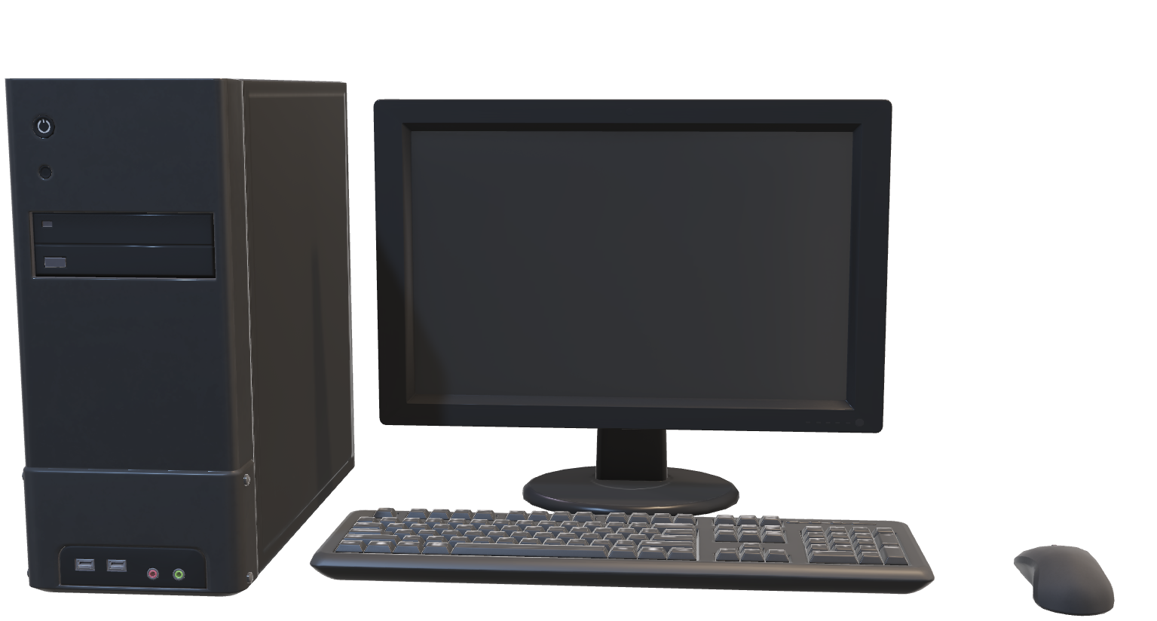
Computer

Slide 4
Input & Output
Input
Output
Keyboard
Mouse
Scanner
Lightpen
Web camera
Monitor
Printer
Plotter
Speakers
Head phone

Slide 5
Memory
The quick brown fox jumps over the lazy dog. The quick brown fox jumps over the lazy dog. The quick brown fox jumps over the lazy dog. The quick brown fox jumps over the lazy dog. The quick brown fox jumps over the lazy dog.
The quick brown fox jumps over the lazy dog. The quick brown fox jumps over the lazy dog. The quick brown fox jumps over the lazy dog. The quick brown fox jumps over the lazy dog. The quick brown fox jumps over the lazy dog.
The quick brown fox jumps over the lazy dog. The quick brown fox jumps over the lazy dog. The quick brown fox jumps over the lazy dog. The quick brown fox jumps over the lazy dog. The quick brown fox jumps over the lazy dog.

Slide 6
Measurement Of Memory

Slide 7

Video

Slide 8
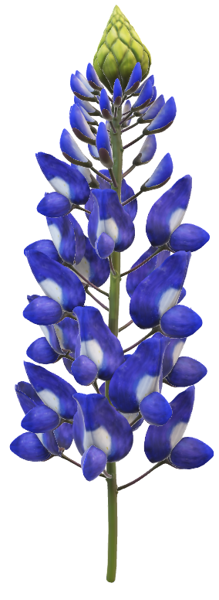
Thanking You
The quick brown fox jumps over the lazy dog. The quick brown fox jumps over the lazy dog. The quick brown fox jumps over the lazy dog. The quick brown fox jumps over the lazy dog. The quick brown fox jumps over the lazy dog.

